Slide 1
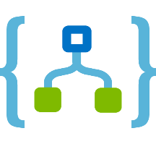
Logic Apps
İbrahim Kıvanç
Software Development Engineer
Commercial Software Engineering @Microsoft EMEA
ikivanc@microsoft.com
Twitter: @ikivanc

Slide 2
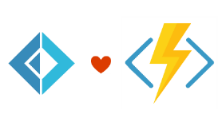


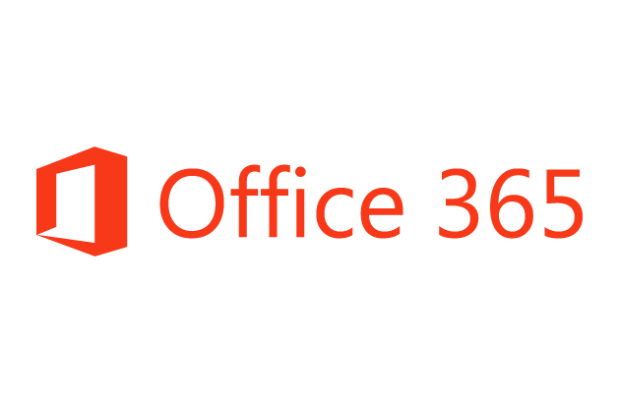
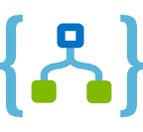
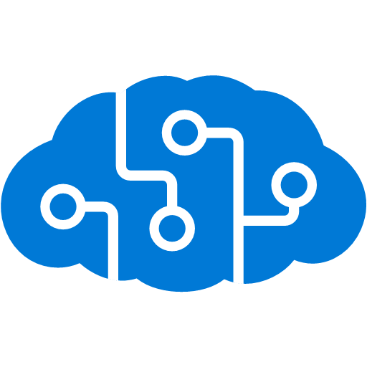
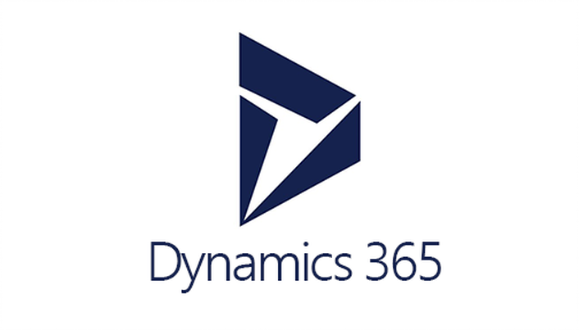







Logic Apps connects everything
Azure Functions
Service bus
Cognitive services
Logic Apps
Machine learning
On-premises data gateway
BizTalk server
Notes:
Logic Apps can integrate with “anything” (APIs) and solve small or complex problems. Automation in a secure and reliable environment fast and easy.
Connect Anything:
On-premises, hybrid and cloud
Mission critical, complex integration scenarios
Business productivity
Agile Business:
Quickly create workflows
Position to the future API centric
Transform Business:
Extract value from both (on-premises and cloud apps)
Build Holistic integration solutions.

Slide 3
Everything? Really?
Okay, not everything. But there are 200 connectors and in
preview is the ability to create custom connectors. And with
Event Grid, we have many more options as well.

Slide 4

SaaS
10to8
Act!
Adobe Creative Cloud
appFigures
Asana
Azure Active Directory
Azure API Management
Azure App Services
Azure Application Insights
Azure Automation
Azure Cognitive Face API
Azure Cognitive LUIS
Azure Cognitive Text Analytics
Azure Cognitive Vision
Azure Data Lake Store
Azure Document DB
Azure Event Hubs
Azure Event Grid
Azure Files
Azure Functions
Azure Machine Learning
Azure Resource Manager
Azure Service Bus
Azure SQL
Azure Storage Blob
Azure Storage Queues
Basecamp2&3
Benchmark Email
Bing Maps
Bing Search
BitBucket
Bitly
Blogger
XML
XML Validation
Transform XML (+Mapper)
Flat File Encode
Flat File Decode
Int Account Artifact Lookup
EDI
X12
EDIFACT
AS2
Protocol/
Native
Batching
HTTP, HTTPS
HTTP Webhook
FTP, SFTP
SMTP
RSS
Compose, Parse JSON
Query, Join, Table, Select
Schedule, Wait
Terminate
Workflow
Hybrid
BizTalk Server
File System
IBM DB2
Informix
Oracle DB
MySQL
PostgreSQL
SharePoint Server
SQL Server
SAP
Teradata
Websphere MQ
Box
Buffer
Calendly
Campfire
CapsuleCRM
Chatter
Cognito Forms
Common Data Service
Disqus
DocuSign
Dropbox
Dynamics CRM Online
Dynamics CRM Service Bus
Dynamics for Financials
Dynamics for Operations
Dynamics NAV
Easy Redmine
Elastic Forms
Eventbrite
Facebook
FreshBooks
Freshdesk
FreshService
GitHub
Gmail
Google Calendar
Google Contacts
Google Drive
Google Sheets
Google Tasks
GoTo Meeting
GoTo Training
GoTo Webinar
Harvest
HelloSign
HipChat
Infusionsoft
Inoreader
Insightly
Instagram
Instapaper
Intercom
JIRA
JotForm
LeanKit
LiveChat
MailChimp
Mandrill
Microsoft Forms
Microsoft Teams
Microsoft Translator
Medium
MSN Weather
Muhimbi PDF
Nexmo
Office 365
Office 365 Users
Office 365 Video
OneDrive
OneDrive for Business
OneNote
Outlook.com
Outlook Customer Manager
Outlook Tasks
Paylocity
PagerDuty
Parserr
Pinterest
Pipedrive
Pivotal Tracker
Planner
Power BI
Project Online
Redmine
Salesforce
Salesforce Chatter
SendGrid
SharePoint Online
Slack
SmartSheet
SparkPost
Stripe
Survey Monkey
Teamwork
Teradata
Todoist
Toodledo
Trello
Twilio
Twitter
Typeform
UserVoice
Vimeo
VS Team Services
Webmerge
Wordpress
Wunderlist
Yammer
YouTube
Zendesk
Cloud APIs and platform functionality
To your services, apps, LOB systems
Hosted and managed within the platform
Scales to meet your needs
First class designer experience
Rapid development
Over 200 built-in connectors
Don’t see what you need?
aka.ms/logicapps-wish
API connections
Authenticate once and reuse
Differentiate connection configuration
Simple to deploy
Portal experience for managing API Connections

Slide 5
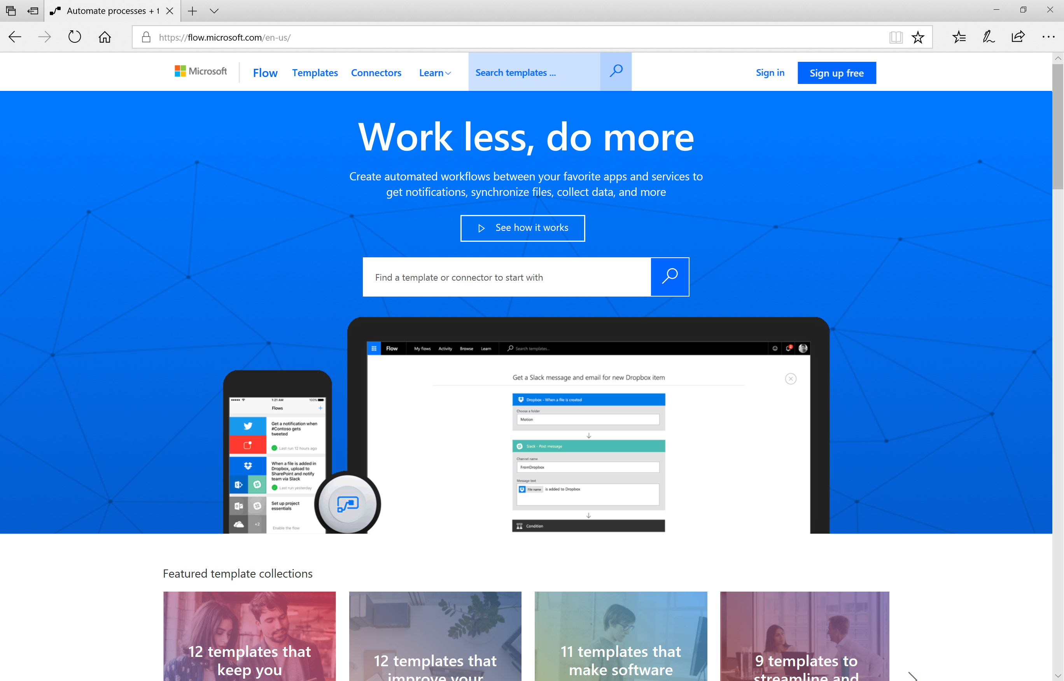

Slide 6
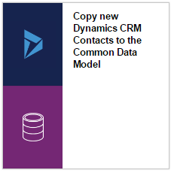
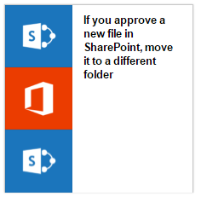
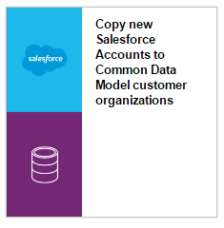
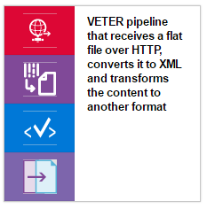
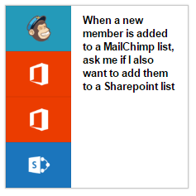
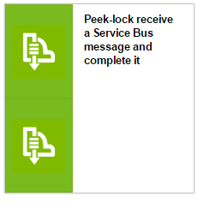
Templates
Rich set of templates
SaaS Integration
Salesforce, CRM, Twitter, Mailchimp, Dropbox, Office 365, SharePoint, etc.
Patterns
Peek lock
Exception handling
Enterprise Integration
VETER
AS2
Templates on Github
Quick Start
Open Source

Slide 7
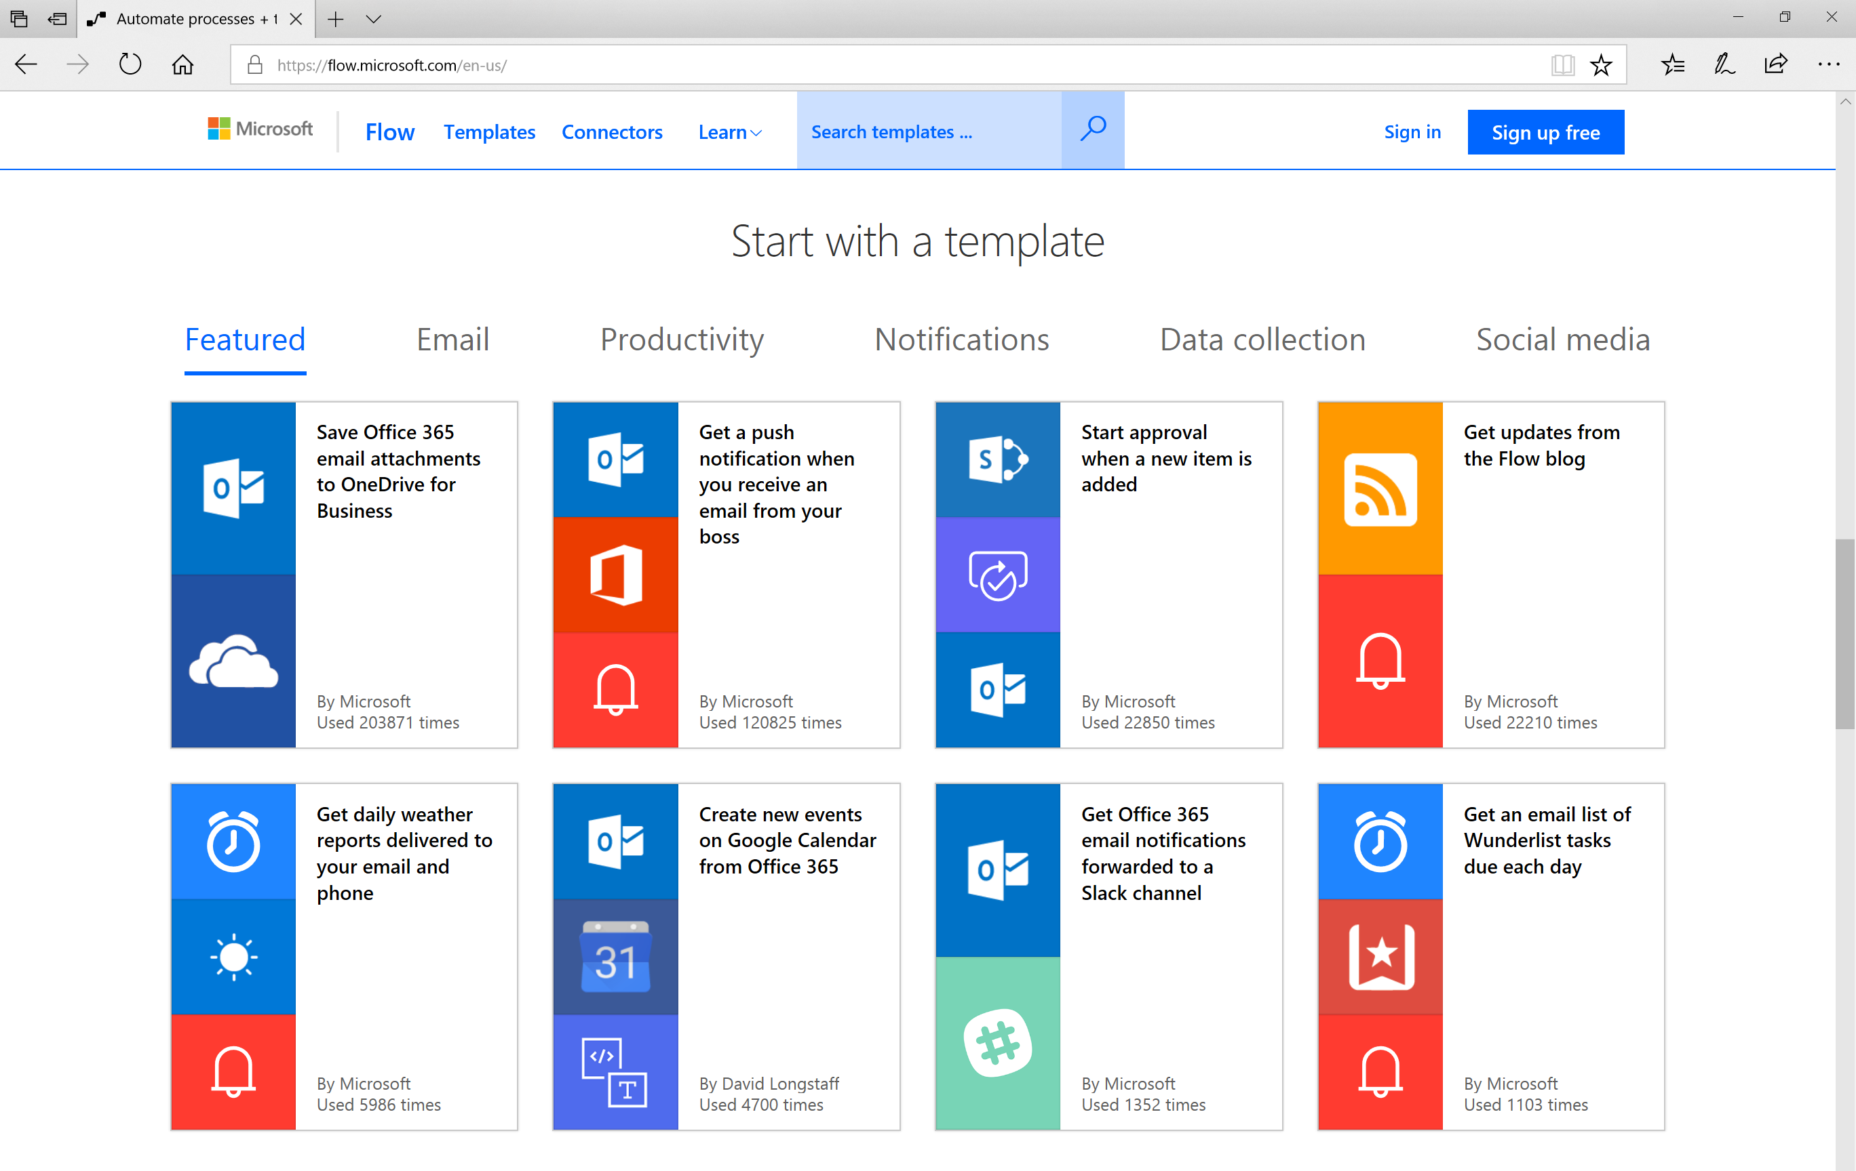

Slide 8



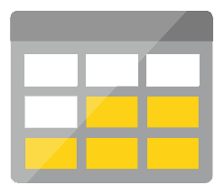
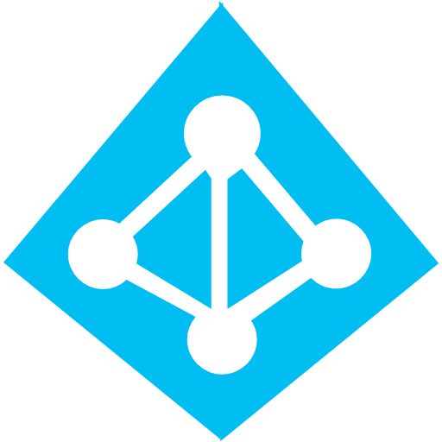



Serverless application platform components
Development
Platform
IDE support
Event Grid
Logic Apps
Functions
Manage all events that can trigger code or logic
Design workflows and orchestrate processes
Execute your code based on events you specify
Integrated DevOps
Local Development
Monitoring
Database
Storage
Security
IoT
Analytics
Intelligence
Visual Debug History

Slide 9
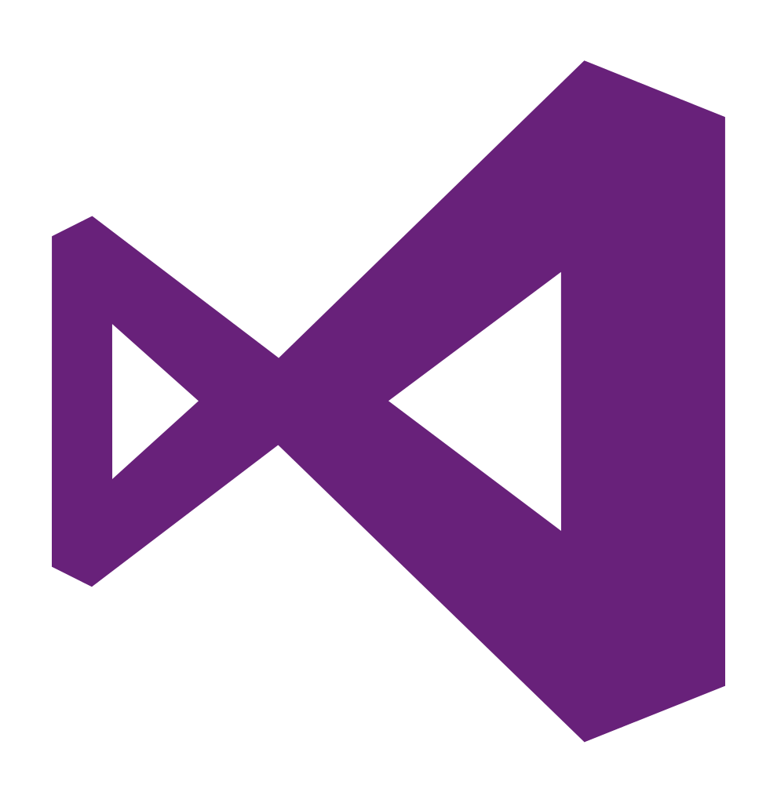
Logic Apps tools for Visual Studio
Hosted Logic Apps designer
Persist using deployment templates
Source Control & CI/CD
Cloud Explorer extension
Integration Account configurability
Develop XML collateral
XSLT Mapper
XML schemas
Flat file schemas

Slide 10
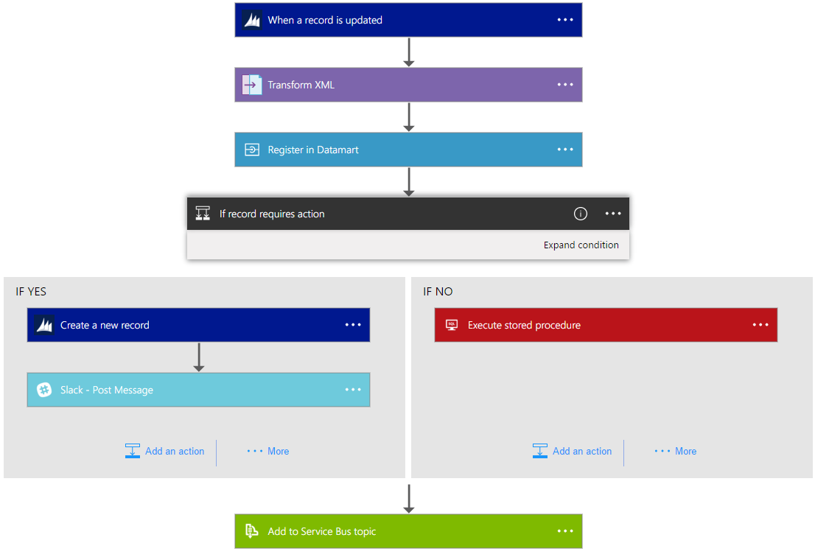
Logic Apps Workflow Designer
Workflow in the cloud
Powerful control flow
Connect disparate applications
No code designer for rapid creation
Also works within Visual Studio for added CI/CD

Slide 11
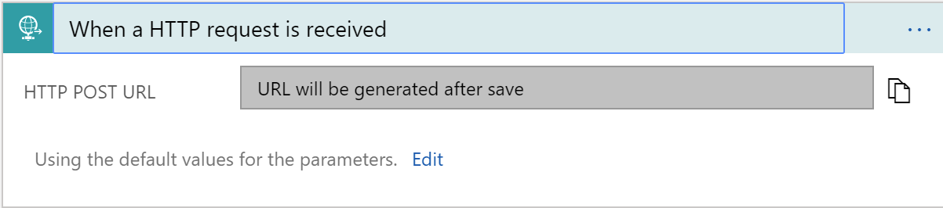
Triggers
All logic apps start with a trigger, typically a connector
Recurring and Adv. Scheduling
Polling
Webhook
Request

Slide 12
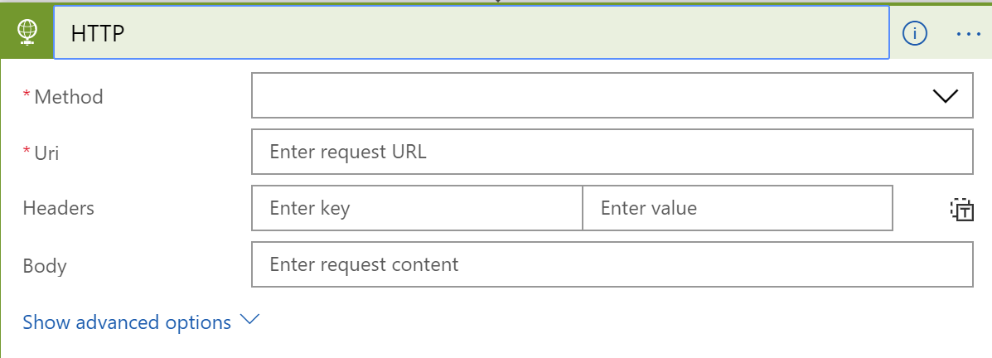
Actions
All logic apps continue with actions, which is also most of the time, a connector
Invoke APIs and Services
Behaviors
Variables
Expressions and Operators

Slide 13
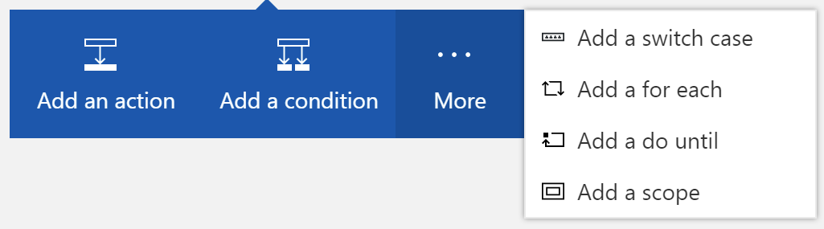
Workflow Features
To control your logic app's workflow, you can specify different paths for your logic app to run and how to process data in arrays, collections, and batches

Slide 14
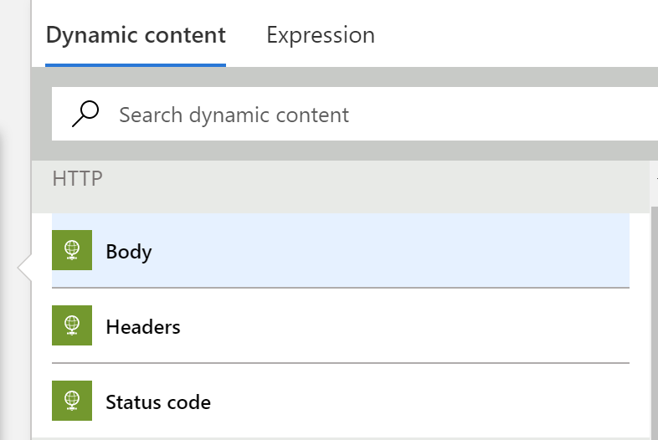
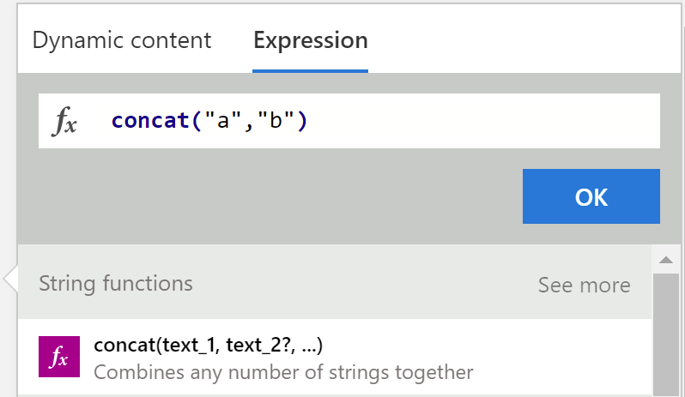
Tips and Tricks
Dynamic Content
Expressions

Slide 15
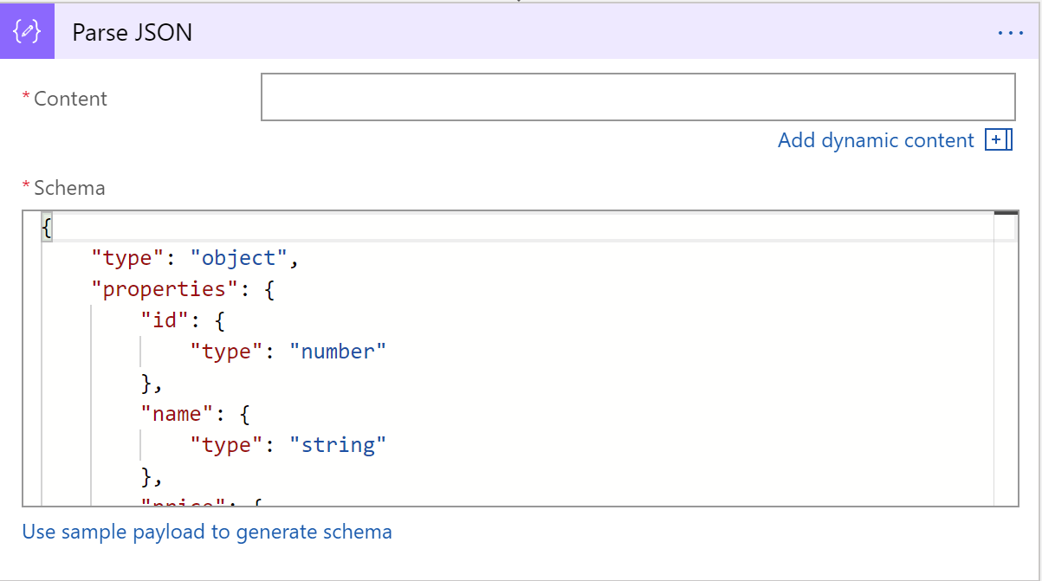
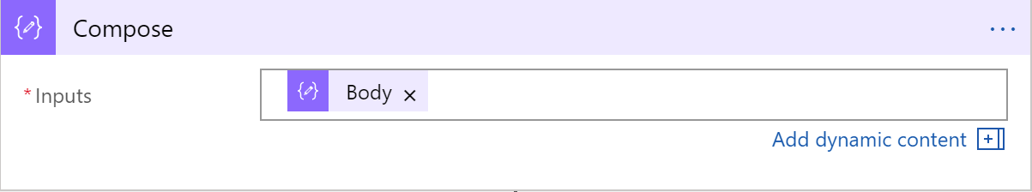
Tips and Tricks
Common shapes that will be used
Parse JSON
Compose
Notes:
Parse JSON – take a JSON object and convert to a specified schema
- constructing any output, including objects, arrays, and any other type natively supported by logic apps

Slide 16
Workflow Patterns

Slide 17
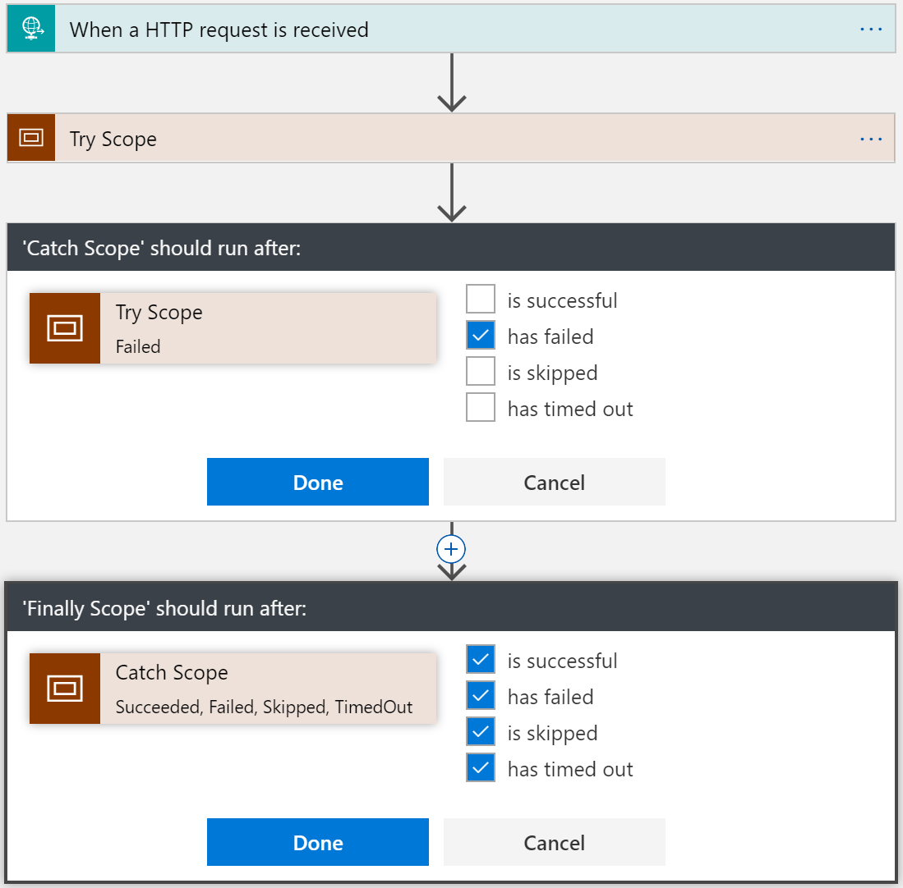
Try-Catch-Finally Pattern
Try
Put actions in a Try scope
Catch
Run after Try scope Failed
Finally
Run after Catch scope Succeeded, Skipped, TimedOut, or Failed
Notes:
Scopes
Encapsulate a set of actions
Status: Determined by the status of the leaf nodes within the Scope
Succeeded: all must have succeeded
Skipped: all must have been skipped
Failed: any not succeeded or skipped

Slide 18
Long Running Processing
Until Condition is met
Do-until loop
Evaluated condition, total time, or count
When a Timeout has occurred
Configure timeout action setting
While other work is being done
Parallel actions

Slide 19
Advanced scheduling
// Occur on the last Friday of every month at 8:30am and 5:30pm
"triggers": {
"Recurrence":
"recurrence":
{
“startTime": "2017-11-01T15:30:30Z",
"frequency": "month",
"interval": 1,
"schedule":
{
"minutes": [30],
"hours": [8,17],
"monthlyOccurrences":
[
{"day": "friday", "occurrence": -1}
]
}
},
"type": "Recurrence"
}

Slide 20
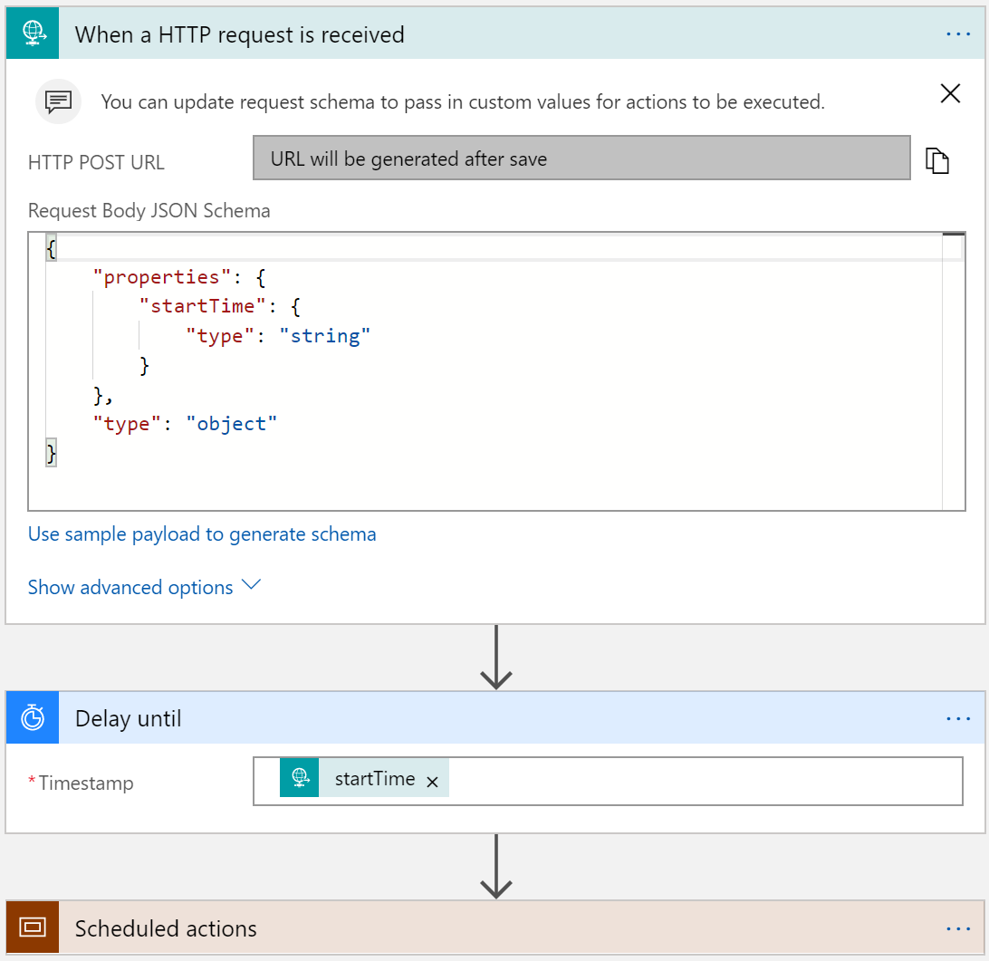
Run Once Jobs
Request trigger
Start time input
Delay Until (start time)
Instantiate millions of scheduled jobs

Slide 21
Demolar

Slide 22
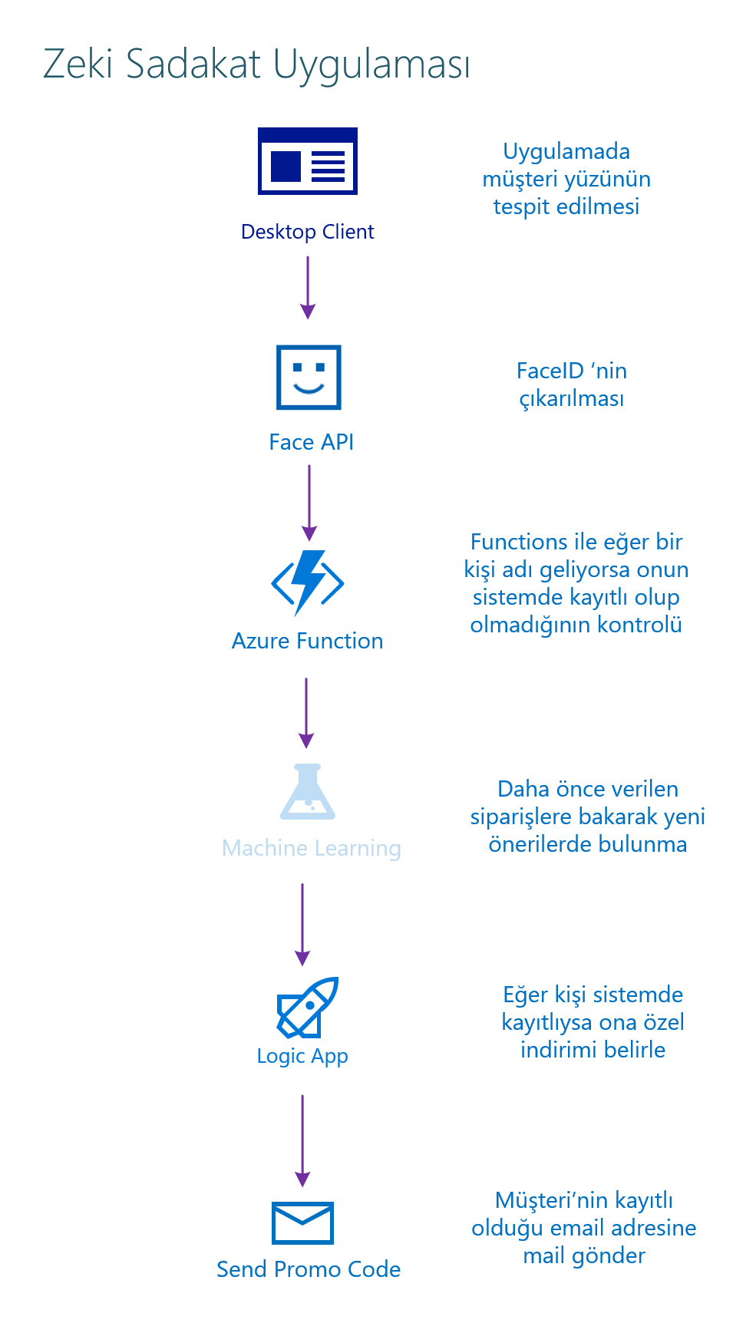

Slide 23
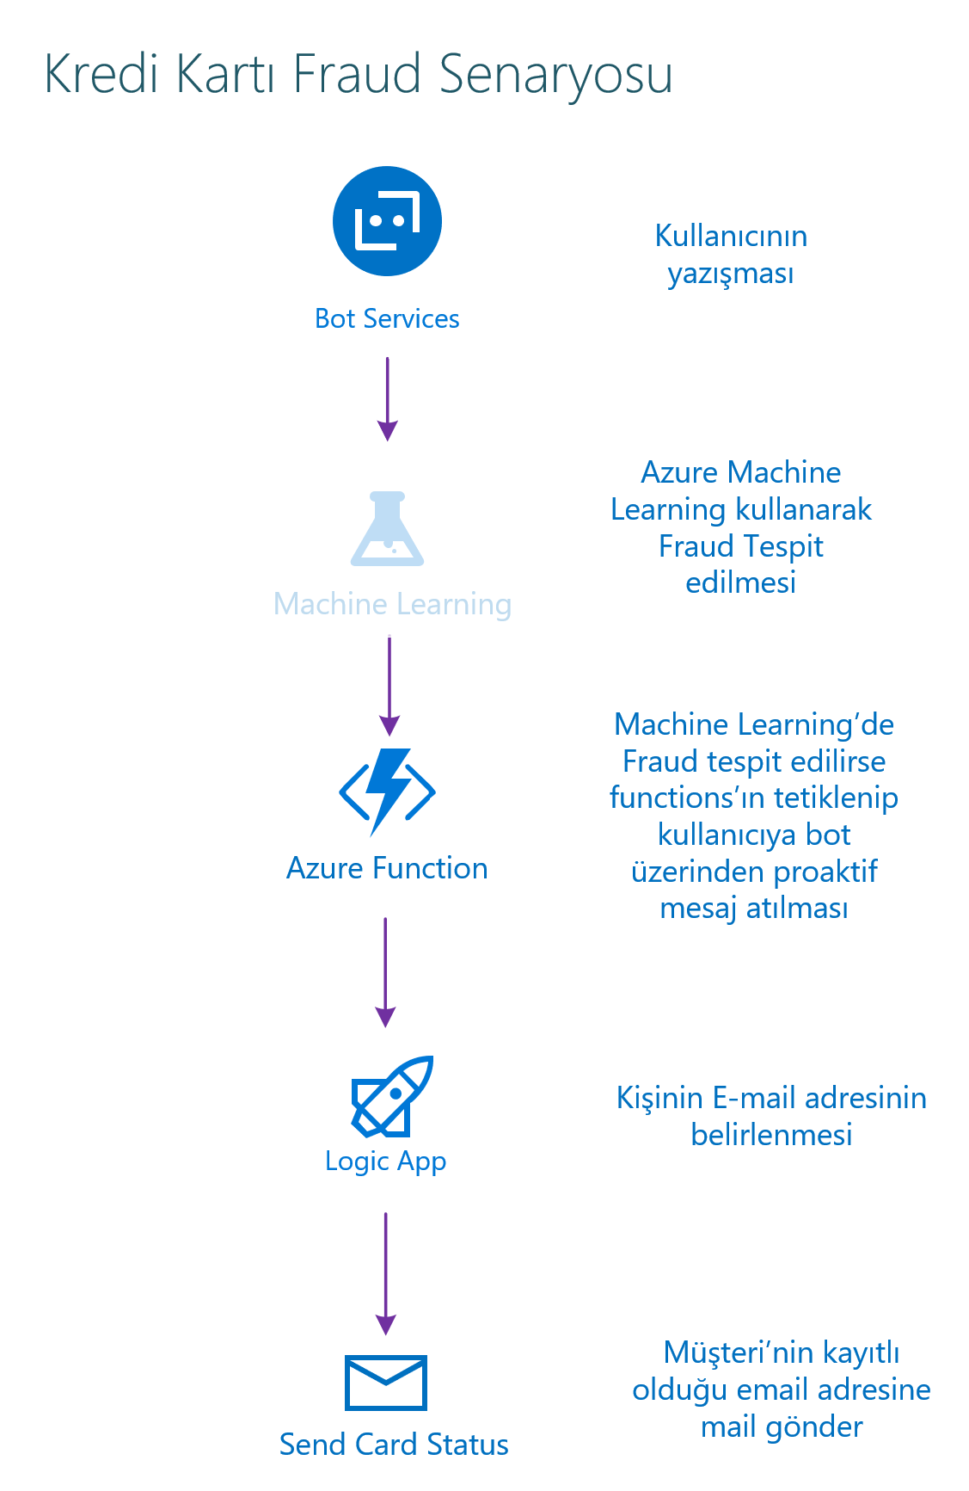

Slide 24
Summary: build apps faster
Logic Apps
Rich portal visual designer and Visual Studio integration
Switch statements and loops
120+ connectors to SaaS and PaaS, with custom connector support
ARM template-based for easy reuse

Slide 25
Kaynaklar
Logic Apps Monthly Webcasts
http://aka.ms/logicappslive
Logic Apps Documentation
http://aka.ms/logicapps-docs
Logic Apps Blog
http://aka.ms/logicappsblog
Logic Apps Ideas
http://aka.ms/logicapps-wish

